Slide 1

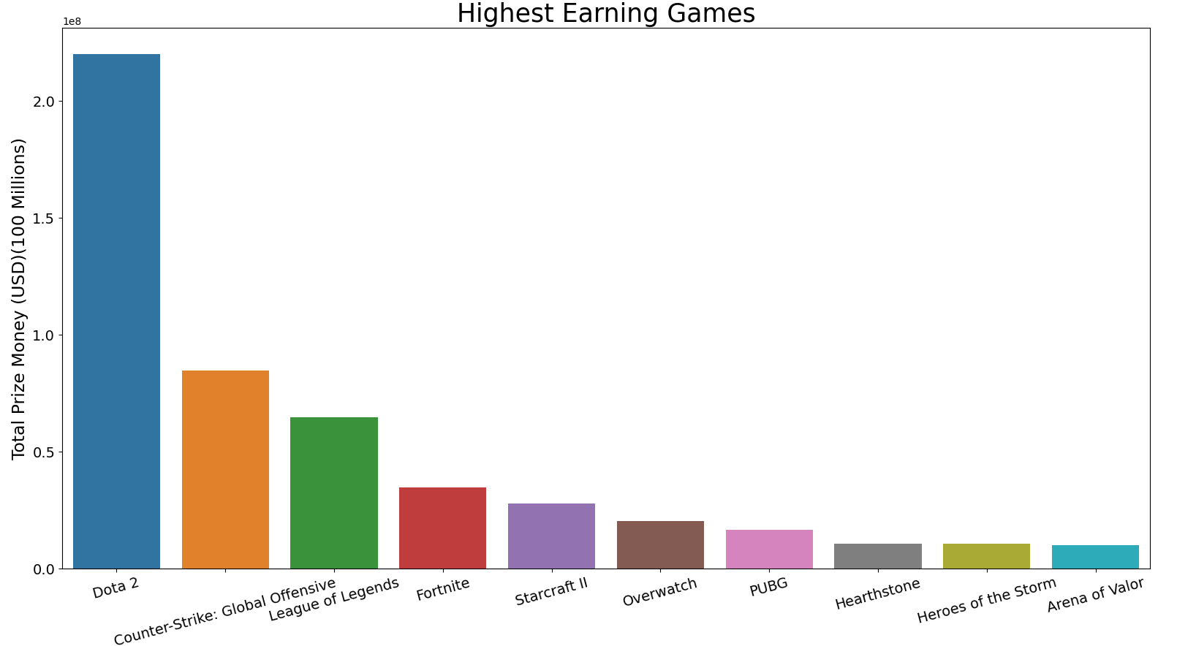
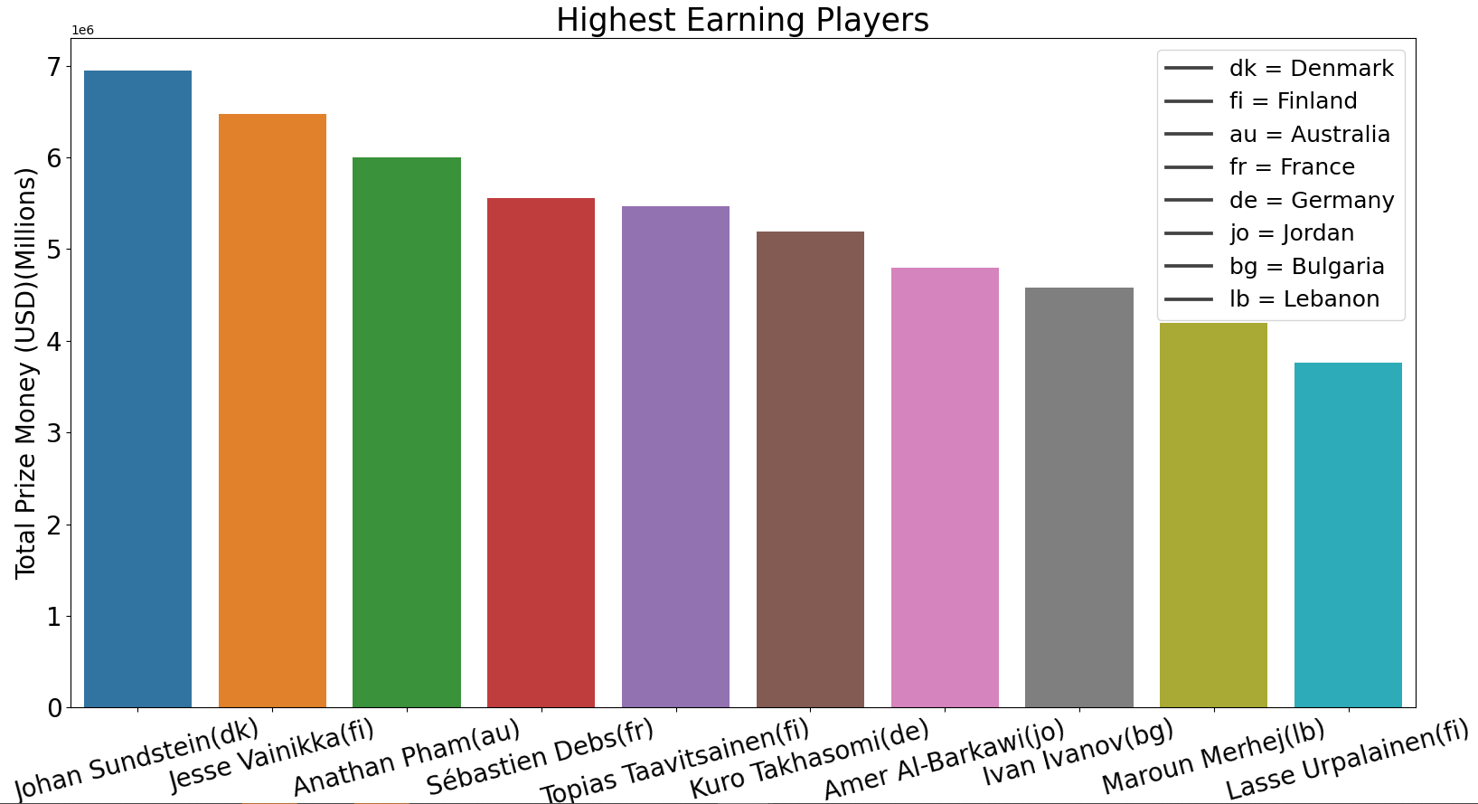
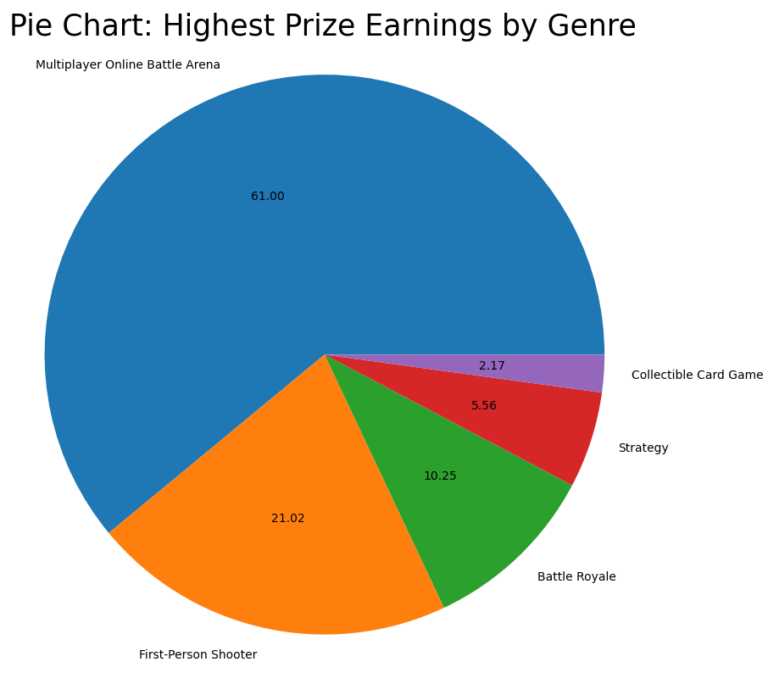
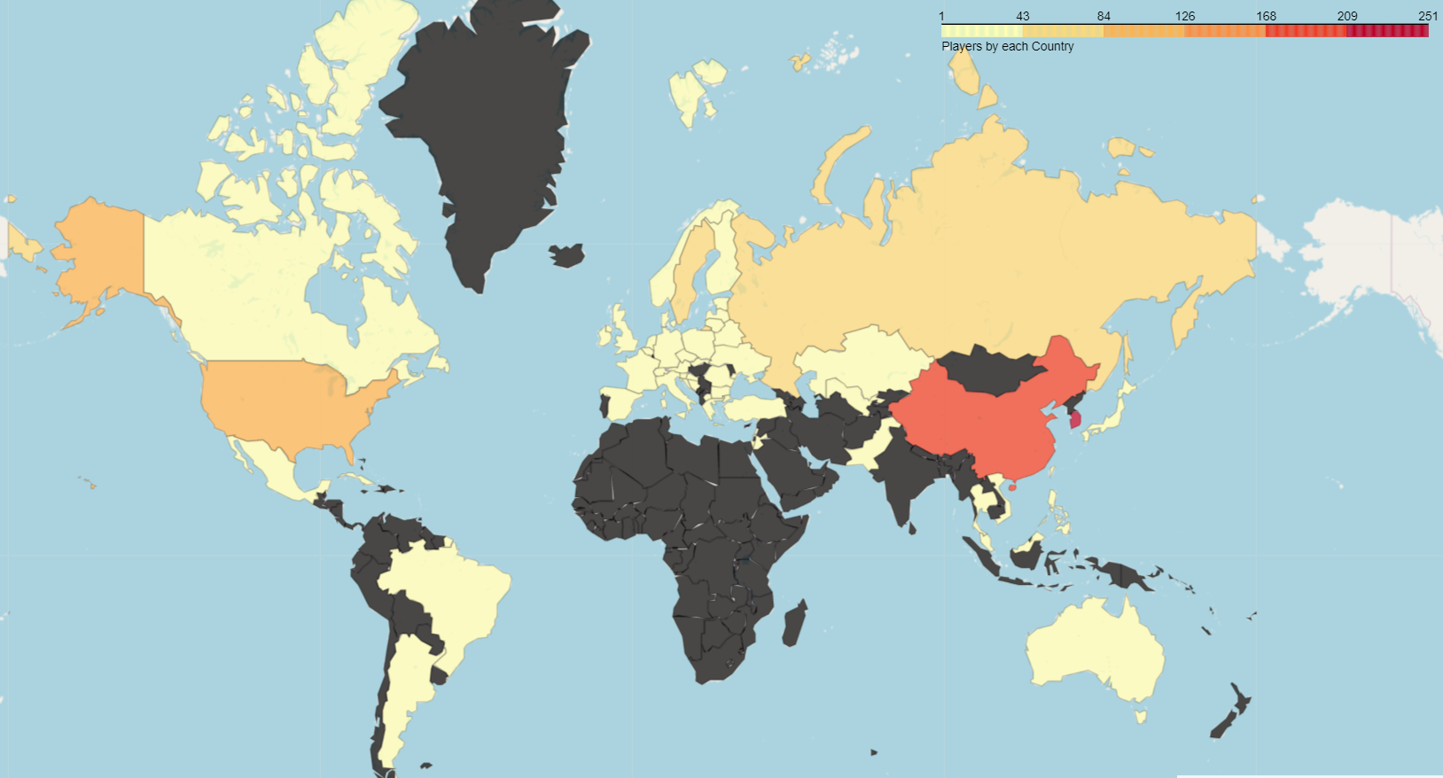
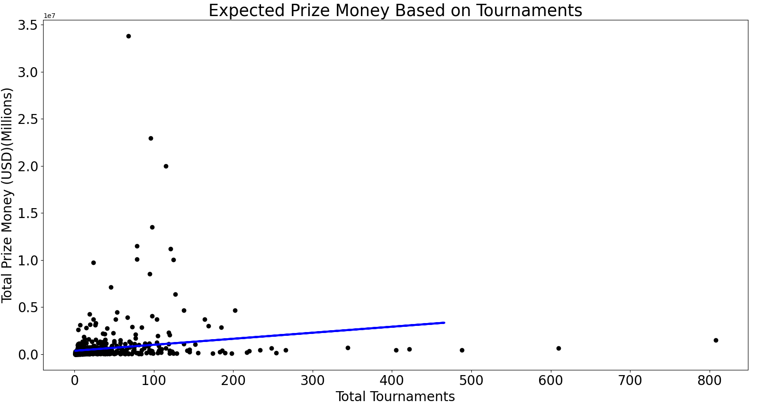
Esports
SENG4400: Data Science– Fall 2022
Keegan Gunkel
School of Engineering
Software Engineering
Data Visualization
Density Map of Pro Players
Linear Regression
With my linear regression model, we can predict a team with 450 tournaments will earn about half a million dollars.
**side note**
Money gained is highly based on the game
Conclusion:
Dota 2 and multiplayer battle arena games are the highest grossing game and genre.
Even though China has the highest density of pro players, not a single Chinese pro player is in the top 10 highest earning players.
Source: Kaggle - esports earnings analysis and regression model - https://www.kaggle.com/code/joshuagoetz/esports-earnings-analysis-and-regression-model

